Slide 1
Contents for a Joint Success Plan (JSP)
Working with [“Vendor” Name]
Original reason for working together
Current utilization and ROI
[“Vendor” Name]’s strategic initiatives for coming year
Improvement planning
Progress since last period on objectives and goals
What’s working
What’s not working
Joint action plan
[“Vendor” Name] update
New capabilities
Announcements
Roadmap

Slide 2
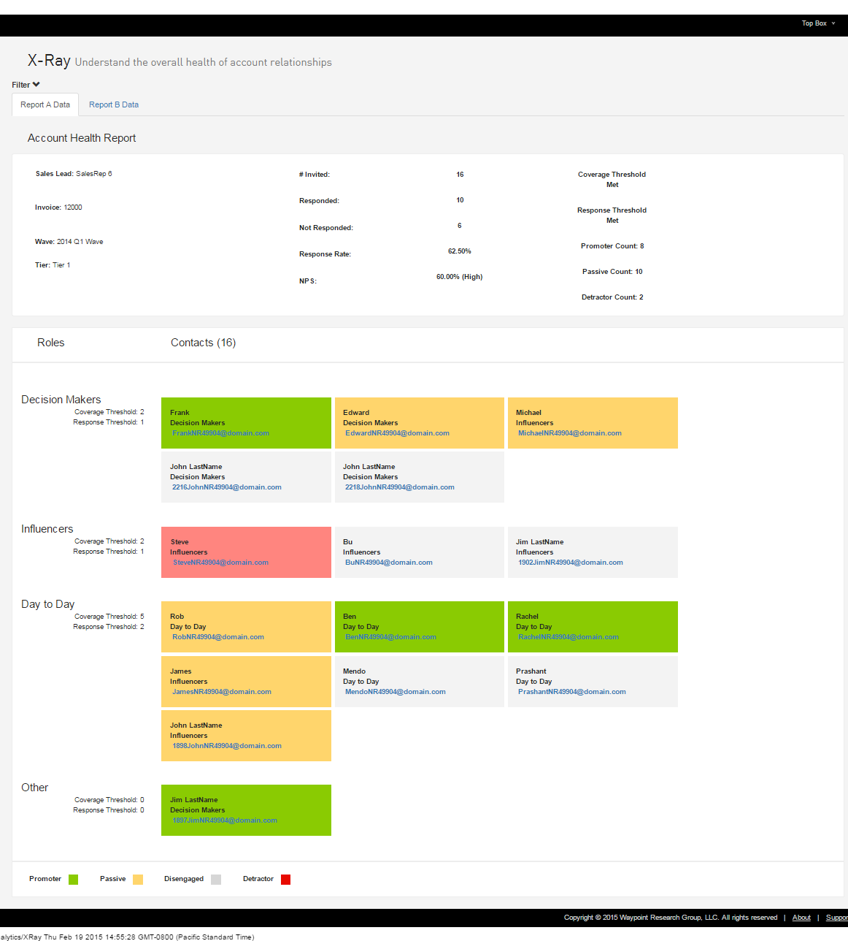
Overall Results
This chart is meant to provide an overview by showing the sentiment of KEY contacts within the account
PLACEHOLDER: PULL CHART FROM TOPBOX

Slide 3
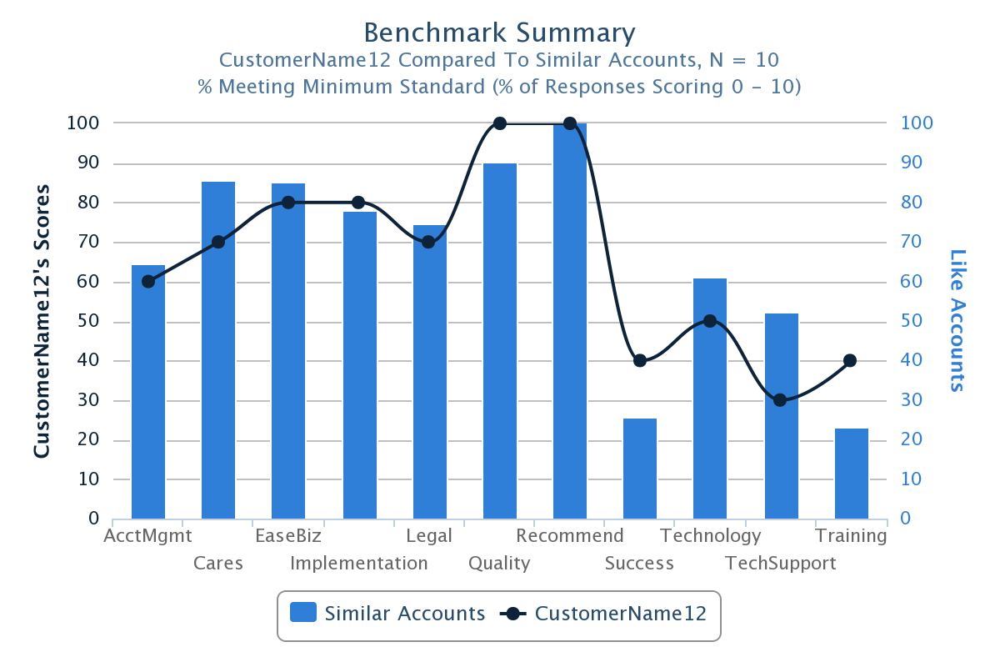
High and Low Performing Areas
What seems to be working well and not working well within the account, compare to similar accounts?
PLACEHOLDER: PULL CHART FROM TOPBOX

Slide 4
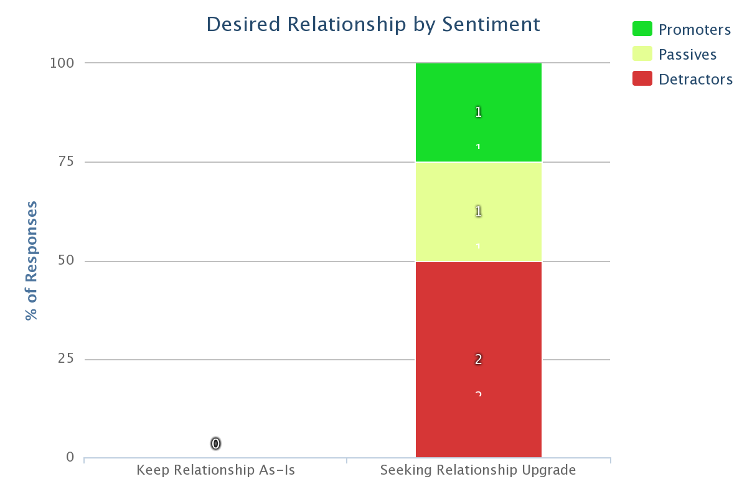
“Relationship Ladder”
Do the key contacts in the account want more out of the relationship?
PLACEHOLDER: PULL CHART FROM TOPBOX

Slide 5
Document What Works with the Account
INTERNAL Observations
(“Draft” of your ideas as to what you think is working well. This needs to be validated by the client in your joint account review meeting)
Client Observations
(What does the client think are the most successful aspects of the relationship)
Meeting Template

Slide 6
Identify Opportunities for Improvement with the Account
INTERNAL Observations
(”Draft” of areas that you believe are critical to be addressed. Discuss and confirm these with priorities in your joint account review meeting with the client)
Client Observations
(What are the areas that the client believes need to be addressed in order to improve their success?)
Rank order each item in order of priority.
Meeting Template
Notes:
Next, you’ll look at the opportunities for improvement. What are the areas that need to be addressed? It’s in this area that you need to establish 2 things:
First: What is the issue and how important does your customer feel the problem is? You might start by asking if the item is “red” or “yellow”, and then prioritize the red items next.
Then, work a plan of action with the customer for resolution. It’s in this area where you can jointly agree on next steps for both the short term and also to eliminate the root cause.

Slide 7
Account Relationship Plan: Individual Contacts + Account Overall
Look at the “Engagement Ladder” to see if they want an “upgrade in the relationship. Discuss, “What does success look like?”
Review the detailed responses for all contacts that influence buying decisions
Work with others on the account team to get additional information on the contact and situation
Define a relationship plan to improve/leverage relationships with those people
Name/Title (or All Acct) | Health | Decision/ Influence | Relationship owner | Next Steps | By When?
 |  | Decision Maker Influencer End User
(0-6) Detractor
(9-10) Promoter
(7-8) Passive
No response

